Slide 1
Python For AI & ML
Organized by
UIU APP FORUM

Slide 2
Outline
Introduction
Python Installation
Python 101
Artificial Intelligence
Machine Learning
Resource

Slide 3
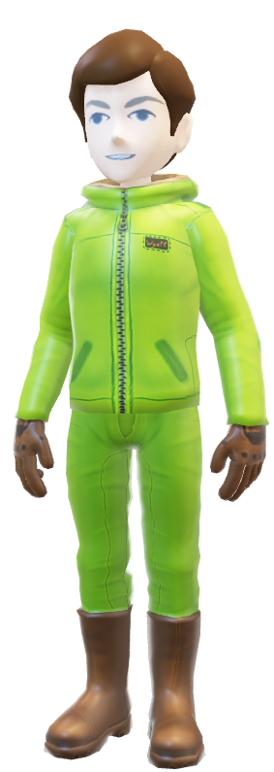
Mazharul Islam Leon
I’m machine learning enthusiast like you
Software Developer at Red.Digital Limited
Jr. Data Science Engineer at CMED Health Limited
Machine Learning Engineer at Tesseract Technologies
Android Developer (Intern) at Ai Robotics Asia Ltd., Edublock.co

Slide 4

What do you think about python?

Slide 5
What is Python
Python is a high-level programming language.
It was created in 1991 by Guido van Rossum.
Python is an easy to learn, powerful programming language.

Slide 6
Scope of Python
Python
Software Development
Mathematic Operations
Data Science
Machine Learning
Many more ..
Web Development

Slide 7
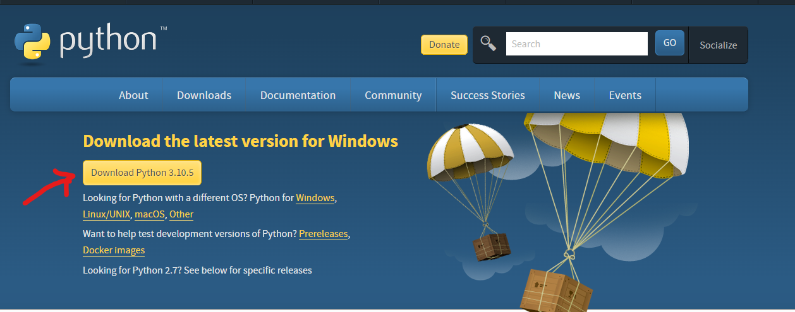
Installation of Python
To download Python interpreter,
go to the site https://www.python.org/downloads and click on the suitable icon

Slide 8
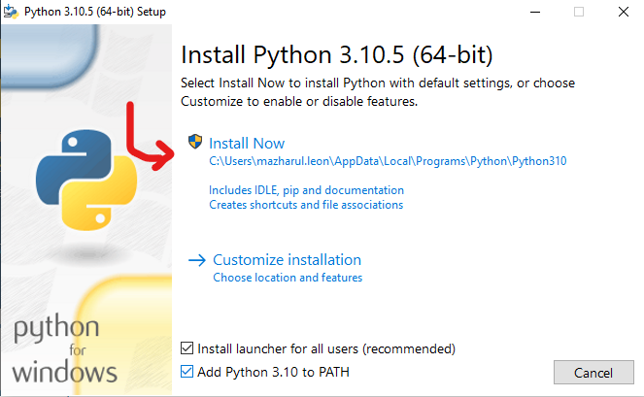
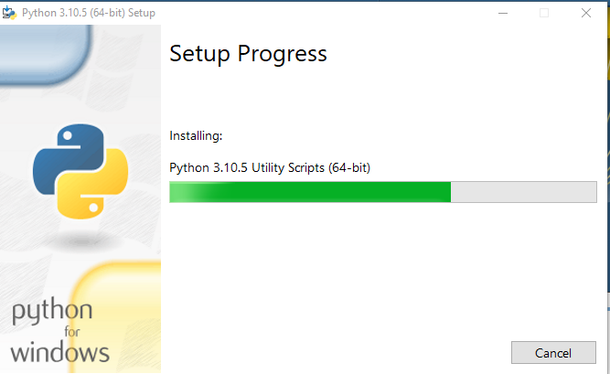
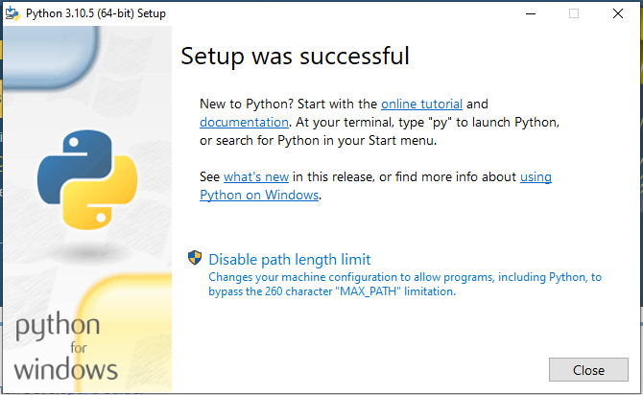
Installation Process

Slide 9
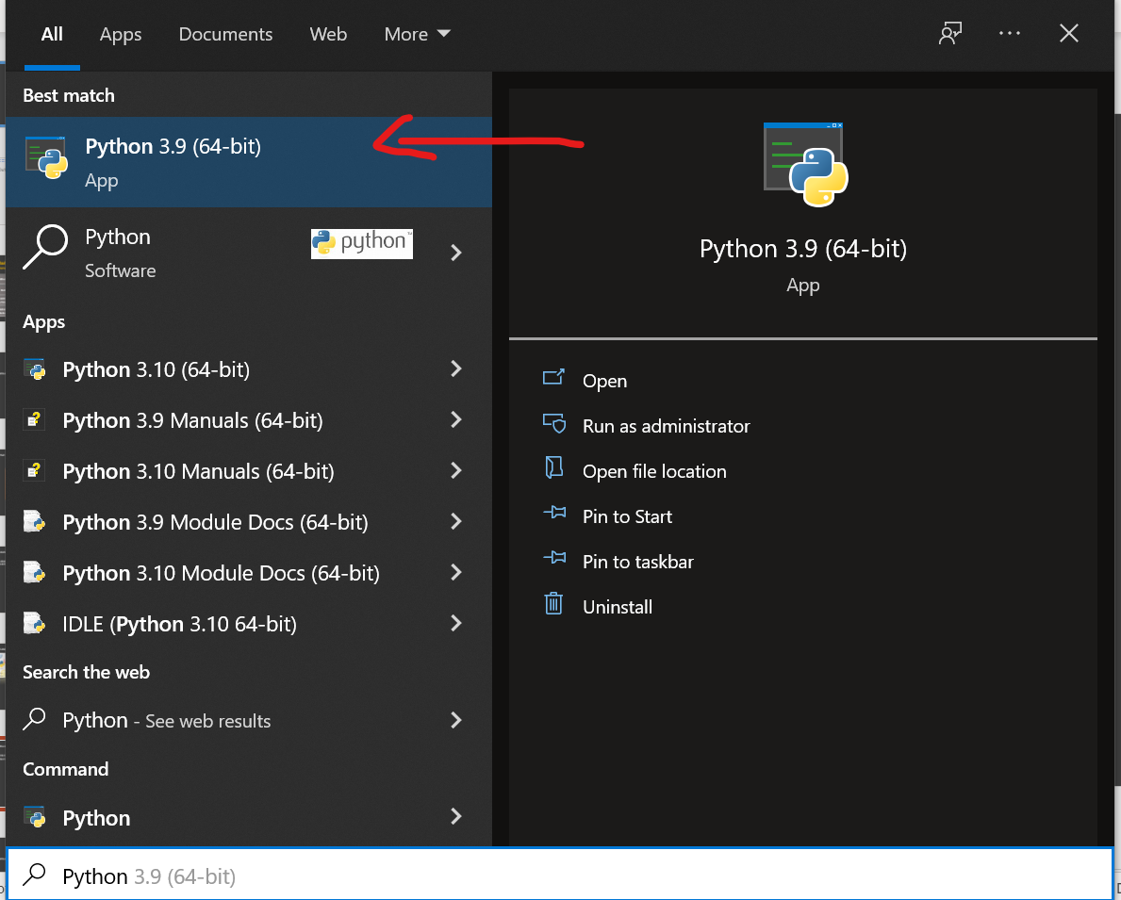
Check Installation Status
Click Start menu
Search Python
Open the Python IDLE

Slide 10

Alternative Solution ?

Slide 11
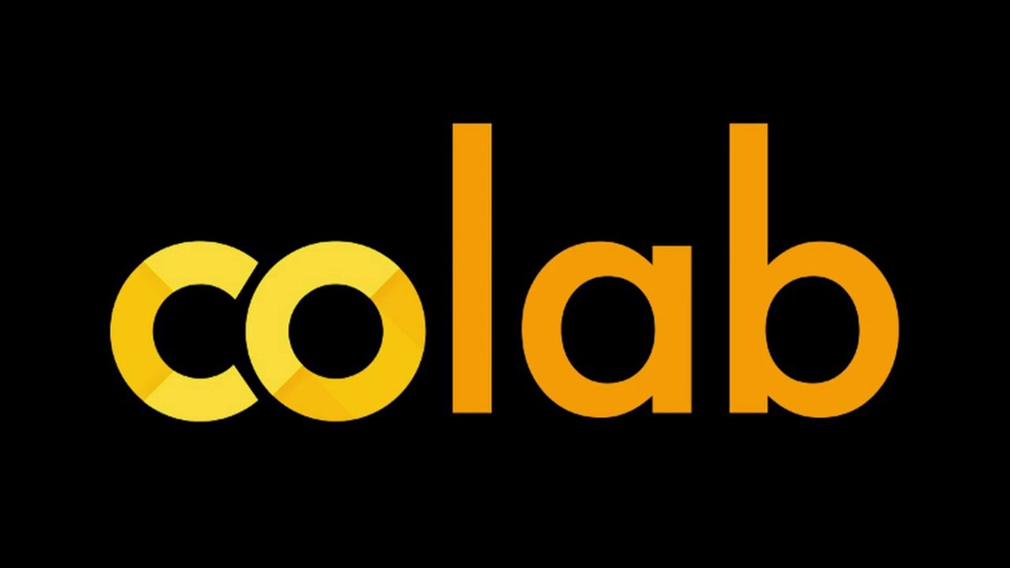
Yes !! Available.
Among them Google Colab is the most popular solution.
Go to https://colab.research.google.com/
Create New Notebook and Connect

Slide 12
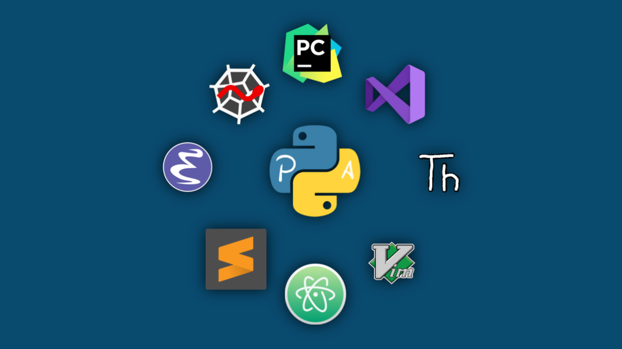
Popular IDE
PyCharm
Visual Studio Code (VS Code)

Slide 13
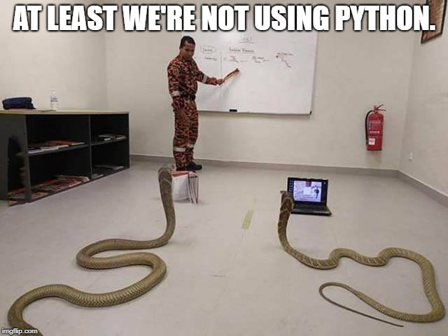
Let’s go for Python

Slide 14
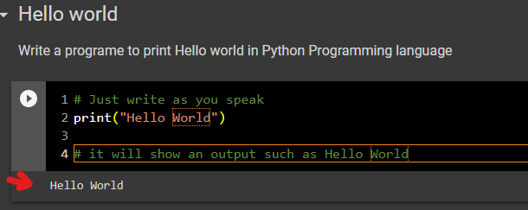

Hello World
Great !! You are a programmer now ..

Slide 15
Hello world
Operators
Data type
Control Flow
Functions
Classes
Modules
Files
What will cover in this workshop

